Slide 1
Indian Institute of Information Technology , Kalyani
B. Tech Project (2nd Year)
JAVA(OOP)-CS403
Submitted By:
Ananya Sarkar (322)
Sneha Sana (399)

Slide 2
Problem Number-11
Student Database Management System
Problem Statement: The system will have a GUI for user interaction and backend database (MySQL). The system will allow user to insert student information in database and search student details

Slide 3
Contents

Slide 4
Introduction
Problem Statement
Scope of Work
Analysis:
1. Database Table
2. GUI screenshots
Conclusion

Slide 5
Introduction

Slide 6
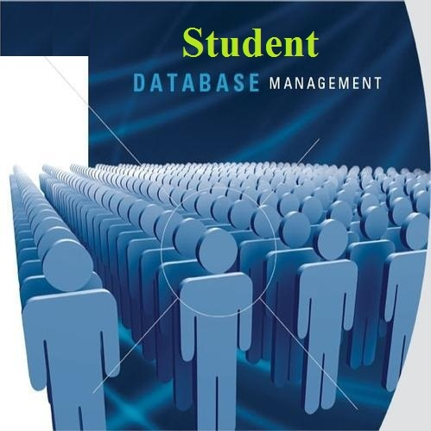
An organized and systematic office solution is essential for all universities and organizations. There are many departments of administration for the maintenance of college information and student databases in any institution. All these departments provide various records regarding students. Most of these track records need to maintain information about the students. This information could be the general details like Student ID, name, address, subjects, grades and SGPA.
All the modules in college administration are interdependent. They are maintained manually. For example when a student needs his or her result of each semester it needs to check many details about the student like his name, student ID, subjects and many other details. So it needs to contact all the modules that are office, department and examination and result of students.

Slide 7
Problem Statement

Slide 8
Student Database Management System using JAVA and MySQL
In this, our approach is to utilize the powerful database management, data retrieval and data manipulation.
We have made GUI for user interaction and used MySQL for storing database of student details.
In this project the admin will login through username and password and can add,search,remove,update any student’s details and also print the result of any student.

Slide 9
Scope of Work

Slide 10
The scope of the project includes the following:
Any college can use this system as it is not client centric.
All examination related work for the student can be done using this system.
By changing Administrator’s username and password in the database this application can be used at any place.
It can be reused not only for showing students’ result but also managing whole Institute management system
Application Support & Maintenance after deployment to production
The Admin Module can be reused for projects as well which have many users with different rights. Hence it is reusable.

Slide 11
Analysis

Slide 12
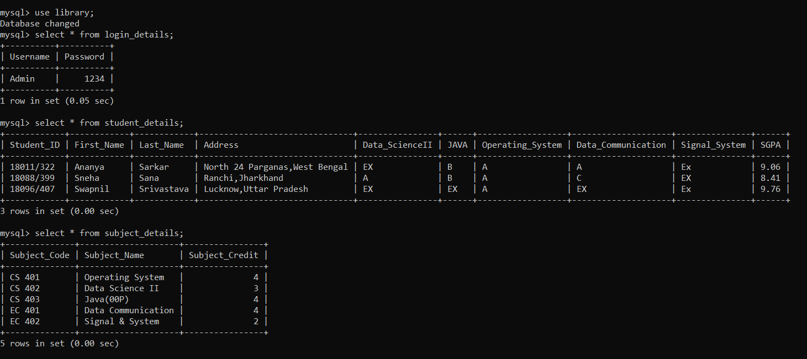
MySQL database: library Tables: 1. login_details 2.student_details 3.subject_details

Slide 13
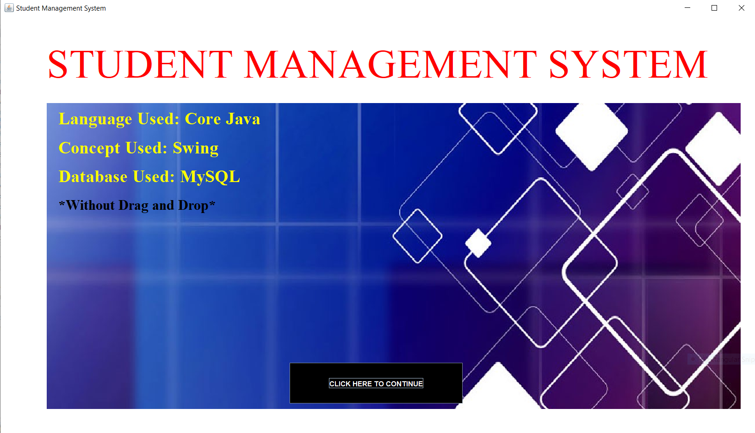
GUI Presentation:
Language used: Core JAVA
Concept used: Swing
Without Drag and Drop
Total classes: 11
Main Class: Front_Page
By clicking on the button “CLICK HERE TO CONTINUE”the user can go to the login page.
Front_Page

Slide 14
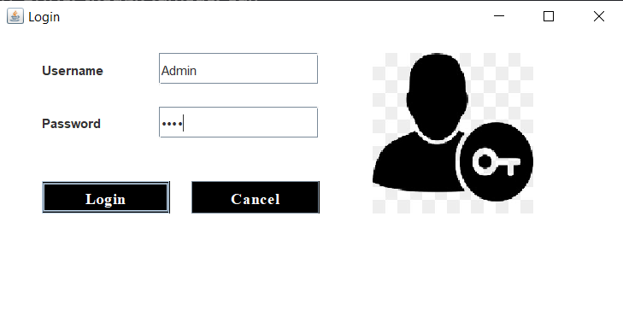
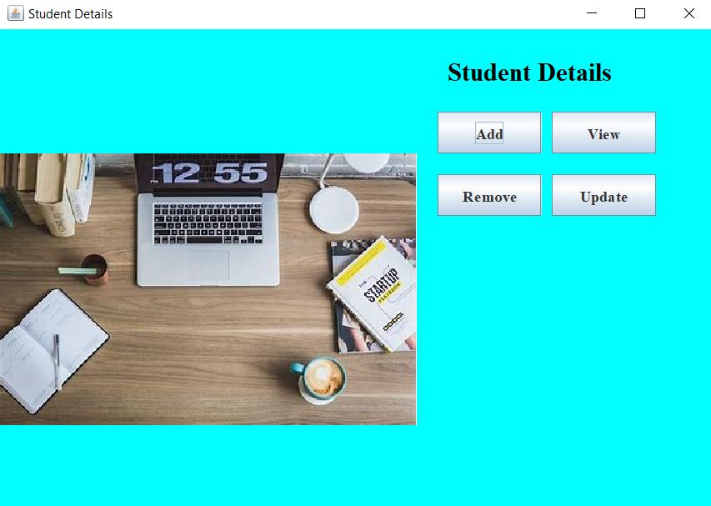
In the user_login table of library database ‘Admin’ is taken in Username field and ‘1234’ is taken in Password field. By entering this information in the Login_Page user can login and go to the next page.
In the next page, there are four buttons to know about students’ details.
Add: To add students in the database
View: To view any student’s result and print it.
Remove: To remove any student and the details from the database.
Update: To update any information of student.
Login_Page
details

Slide 15
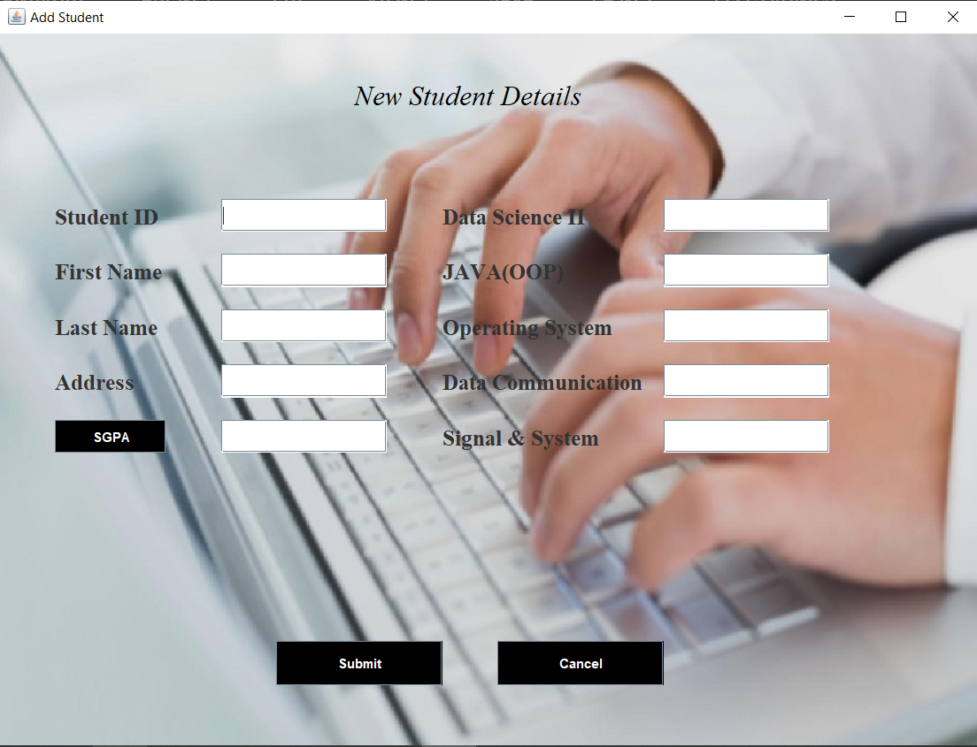
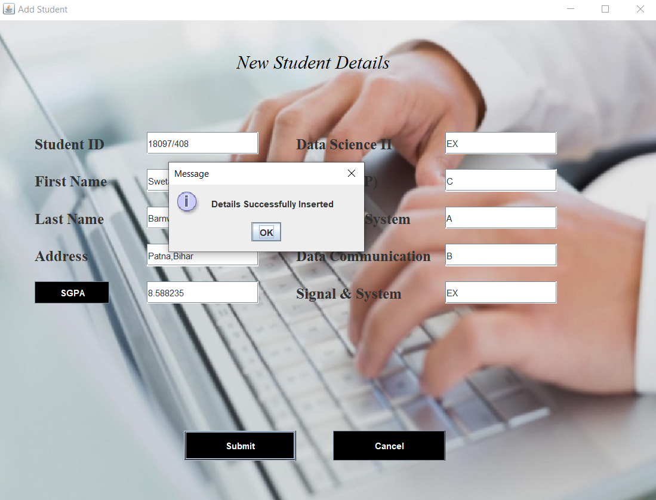
1. Clicking on Add button on details page:
Blank Add_Student Page
(for adding new Student Details)
After filling the form when the SGPA button is clicked SGPA is calculated and when the Submit button is clicked the details of this student are successfully inserted in the database.

Slide 16
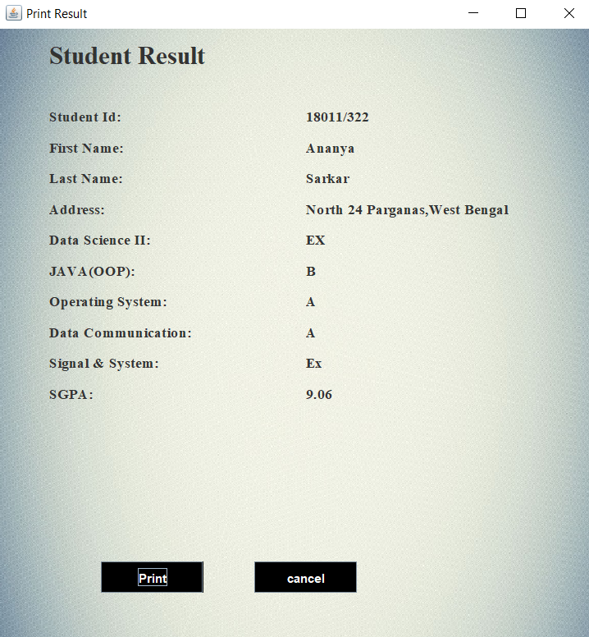
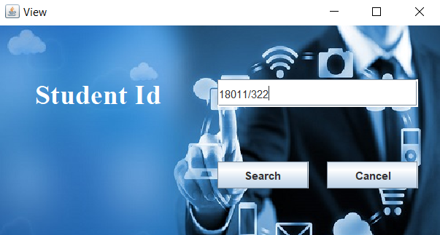
2. Clicking on View button on details page:
View Page is opened and if the written Student ID is matched with any of the available Ids in the student_details table the particular student’s result will be printed, else it will show ‘Invalid Student ID’.
Print Result

Slide 17
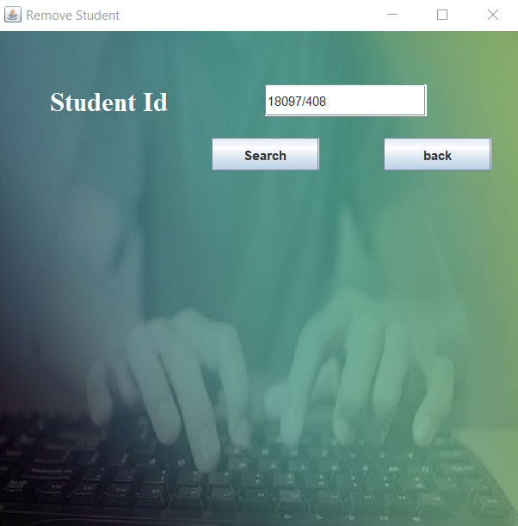
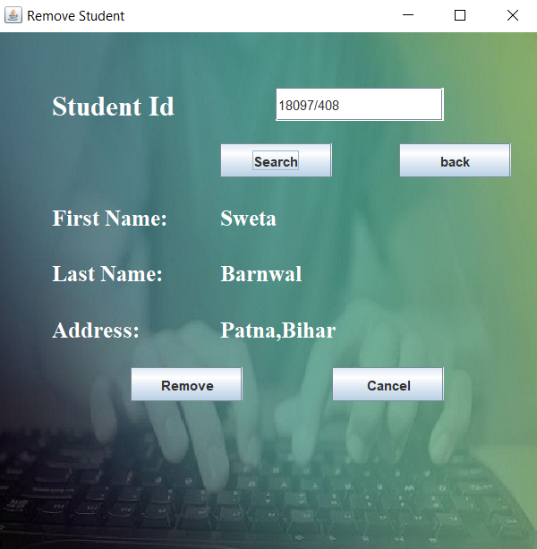
3. Clicking on Remove button on details page:
Remove Student Page is opened and if the written Student ID is matched with any of the available Ids in the student_details table the particular student’s result will be deleted, else it will show ‘ Id not found’.
If the search becomes successful the first name, last name and address will be shown. When the Remove button is clicked the details are deleted successfully.

Slide 18
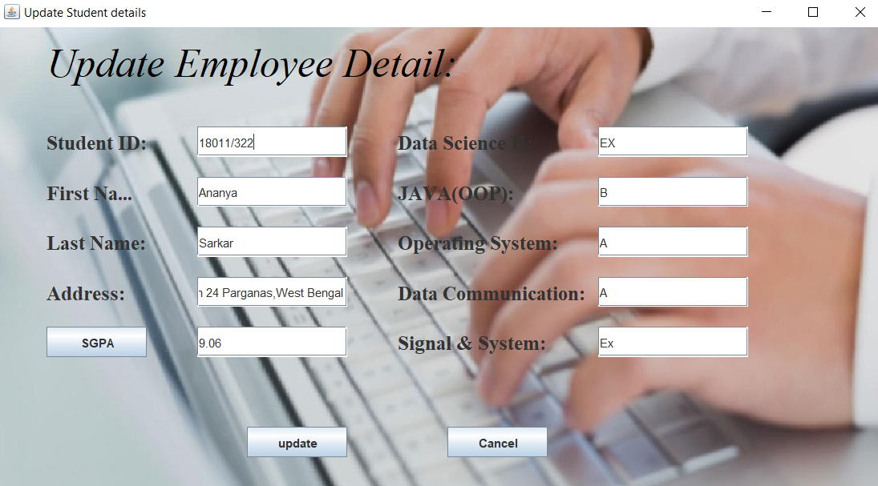
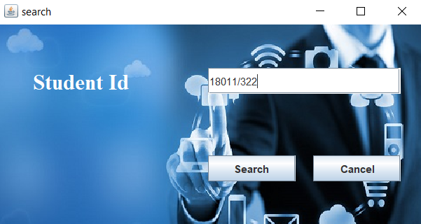
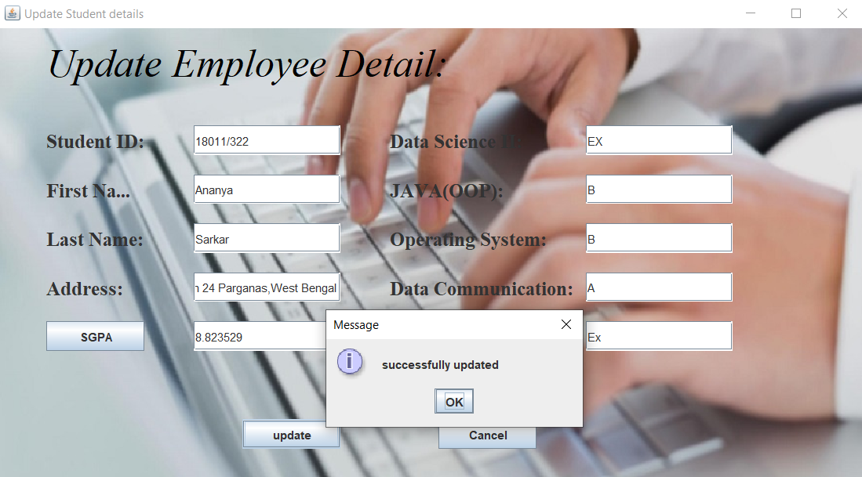
4. Clicking on Update button on details page:
After clicking on Search button for a valid Student Id all details of the particular student will be shown in Update Student details page. After updating some information if the Update button is clicked the information will be updated successfully.
i.e. Previously Operating System grade was A. After changing it from A to B and calculating the new SGPA the details will be updated successfully in database table by clicking the update button.

Slide 19
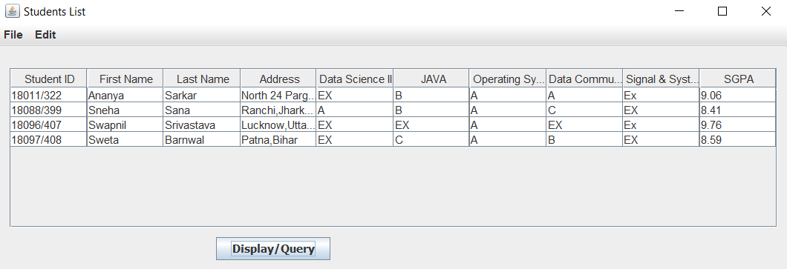
Clicking on Update button on details page:
In the Student package Student, Show_Data class is made to check Students List clicking on Display/Query button after doing any change in the database table.
Students List

Slide 20
Conclusion

Slide 21
Student Management System can be used by educational institutions to maintain their student records easily. Achieving this objective is difficult using the manual system as the information is scattered, can be redundant and collecting relevant information may be very time-consuming, particularly SGPA calculation.
All these problems are solved by this project. This system helps in maintaining the information of pupil of the organization. It can be easily accessed by the manager and kept safe for a long period of time without any changes.

Slide 22
References
https://courses.cs.washington.edu/courses/cse331/13sp/lectures/lect23-graphics.pdf
freebookcentre.net/JavaTech/Free-Java-Gui-books-download.html
MYSQL in a Nutshell
Learning MySQL

